Slide 1


Sustaining your Middle School
Adapted from The Mind-Full Project Plan to serve middle schools who want to involve students to restock their kits.

Slide 2
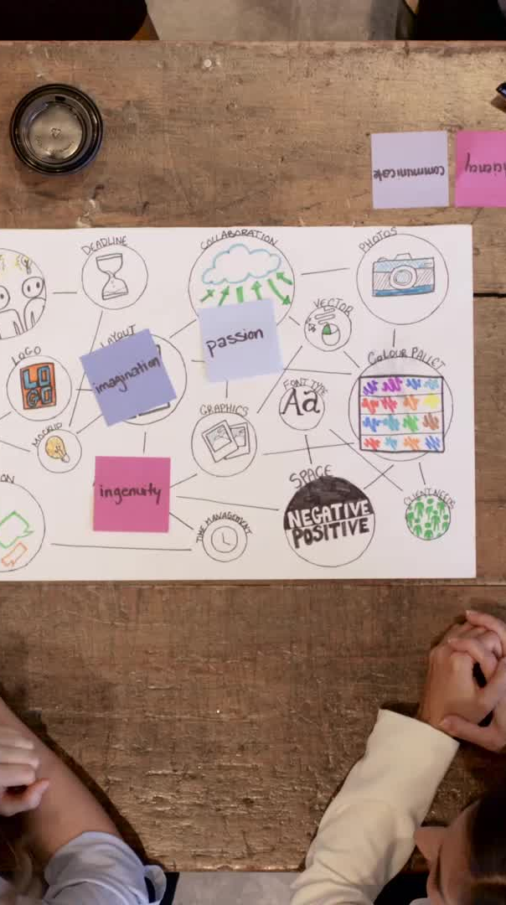


Sustaining your school
Organize a meeting with student leadership
Show them the box and contents.
Explain why its used and what its used for.
Why you need their help.

Slide 3

Recycling Drives & Material Collection
What are the rules on material curation and magazines? Be sure to state this.
How will you set up the drive – how many do you want to run?
If you start early, you can run one drive and see how much you collect. You may not need 2 a year unless the students enjoy it.
Do you want to offer incentives from teachers and school administrators? Hold a classroom challenge contest? 6th, 7th and 8th grade class contest?
Have the art teacher focus on new rules in the classroom with the box and recycling. Make it a room fixture. Art room mindfulness on collecting material should be a focus.

Slide 4
Student participation
Leadership incentives for students or kids who will stay after school to sort material or help with magazines
Do you want them to cut magazines? Or use your local high school clubs to curate magazines your student body collects?
If you choose your students, after school events for one to two hours work well in large groups and once a month events can make a big difference. Finding hidden words in magazine ads is educational.
Allow the kids to decide what is included in the boxes by letting them participate in material selection. This results in a positive message from the administration. It becomes their box. What would they like to see? By making them feel like they are the owner of these boxes, the boxes will be more likely to be used to benefit others or themselves.
Teaches empathy and support for others by learning about the boxes and why its there. A box created by students for students their age sends a positive message.
Tell a lot of students about the program and you may get volunteers. Incentives are helpful as well. What can they earn?
If you have Girl Scouts in your school, this program counts as a “take action” community service task. Especially for girls who want to earn Sliver Award. Boy Scouts may be able to earn service hours or badges.

Slide 5
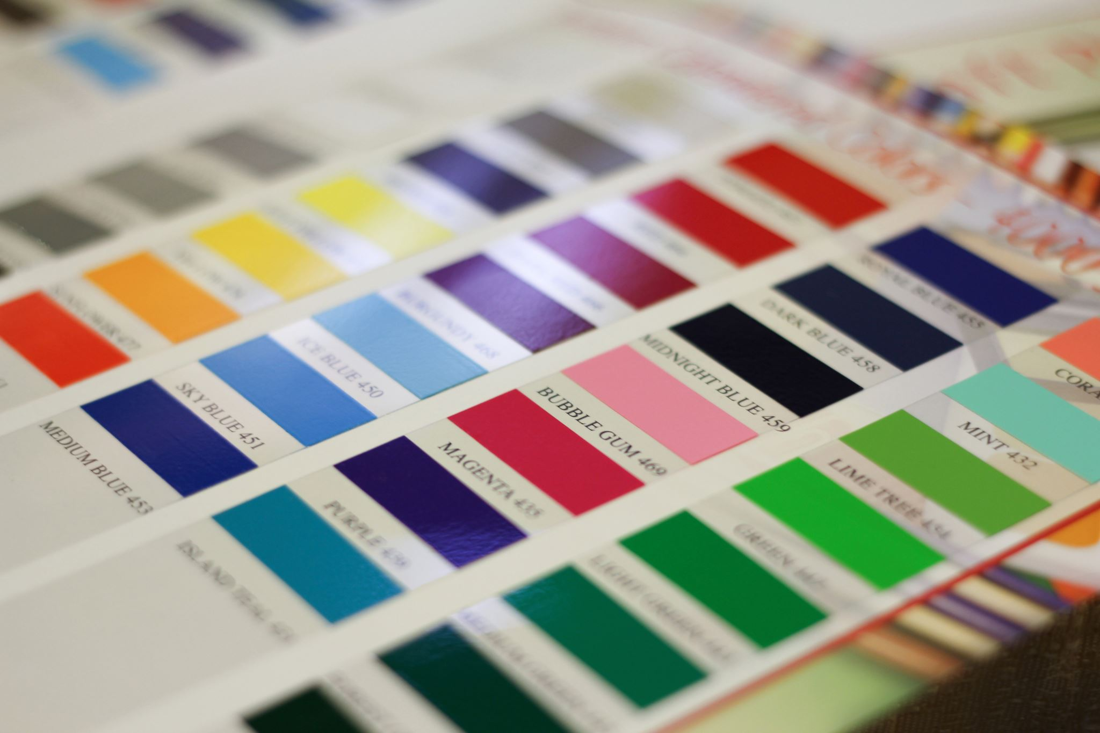

SAMPLE EDITABLE SIGNS

Slide 6
Recycling Needs
Construction paper (colored)
Wrapping paper, origami paper
Old used paper (printed on one side)
***Magazines
Old books or pages
Tissue paper from gift wrap
Semi used art supplies donation
(glue sticks, pens, Elmer's glue, crayons) Or just donation ☺
Greeting cards, postcards, gift tags
Colored or patterned card stock paper
colored twine
Ribbons, patterned craft tape
Buttons
Glitter and glitter pieces
Stickers
Colored Straws (non-bend)
Googly eyes
Pipe cleaners or yarn
Clear or colored cellophane
Feathers or beads (not too small)
Old Calendars
Poster board (regular weight)

Slide 7
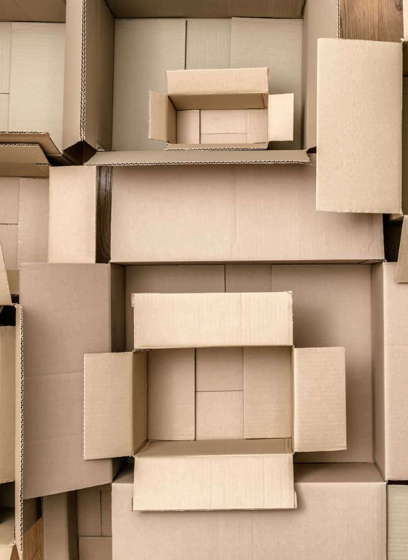
Mind-Full: A School Service Project
Help the counseling office re-stock our collage kit material boxes.
Material needed by first week of {Date}
Donation Boxes also located in rooms: { }
Incentives or contests
Feel free to make it your own – let a student help design it

