Slide 1
Recycling Needs
Construction paper (colored)
Wrapping paper, origami paper
Old used paper (printed on one side)
***Magazines
Old books or pages
Tissue paper from gift wrap
Semi used art supplies donation
(glue sticks, pens, Elmer's glue, crayons) Or just donation ☺
Greeting cards, postcards, gift tags
Colored or patterned card stock paper
colored twine
Ribbons, patterned craft tape
Buttons
Glitter and glitter pieces
Stickers
Colored Straws (non-bend)
Googly eyes
Pipe cleaners or yarn
Clear or colored cellophane
Feathers or beads (not too small)
Old Calendars
Poster board (regular weight)

Slide 2
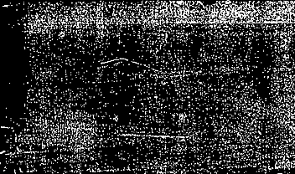

Mind-Full: A Community Service Project
A community service project. Supplying Collage Art Kits to:
  Serve K-12 School Counselors
  Art therapists
  Crisis Centers and Family Advocacy Groups
  Students who want to channel stress into something meaningful
Material needed by {}
Donation Boxes also located in rooms:{ }

